Slide 1
Cyberbullying in Singapore
S10208495 Marcus Yeong
S101208206 Lim Shiwu Nigel
Notes:
Nigel
Good Afternoon Ms. Stella and fellows' classmates, I like to quickly introduce myself I am Nigel and my team member for today presentation is Marcus. In today presentation we will be talking about the topic on cyberbullying in Singapore.

Slide 2
Introduction
Cyberbullying was first known in 1988 it was also known as “Online bullying” such as sending mean message to a person anonymously.
It is a form of bullying or harassment through electronic means where someone posts hateful comments or threats online.
Nigel
Notes:
Nigel
Today topic we are covering on cyberbullying, so what's cyberbullying really means? Cyberbullying was known from 1988 it was called as "Online bullying" such as like posting and sending insulting text message or even mean text. All the form of bullying and harassment or even me can be taken place through digital device such as like phones or even computer and tablets. Cyberbullying acts sometimes can crosses the line such as like criminal behavior and mean content done by the bully.

Slide 3
Background Information
According to CNA article, the cyberbullying rate has gone up. Three out of four teenagers being the victims of the cyberbullying issues. Cyber bullying like using electronic communication.
Olivia Lin. (2020, 04 04). Cyber bullying is a growing danger in S’pore & you should be concerned about it. Retrieved from Mothership: https://mothership.sg/2020/04/cyber-bullying-singapore/
Nigel
Notes:
Nigel
According to CNA article, the cyberbullying rate has gone up in the years and have cause three out of four teenagers being the victims of cyberbulling. Cyber bullying like using electronic communication can use to humiliating and even posting insulting picture online of the victims. All this can cause the harm of the online reputation of everyone involved, not just the person being bullied but also the bullies that are doing those things.

Slide 4
Purpose
In this report we will be going to touch on why cyberbullying happens and how it affects someone.
While also giving recommendations on how to prevent and deal with it.
Nigel
Notes:
Nigel
So for the points that we will be going to be covering on today points are like "Why & How does cyberbullying occur?" Secondly, "How does cyberbullying affect the bully & victim? Thirdly, "Effect of getting cyberbullied" and lastly the "The measures that are taken in Singapore". Cyberbullying is bullying over the internet. As technology is getting more widespread, it has become more frequent over the time. With all this the purpose are to respond to all form of cyberbullying and educating the public of awareness through this cyber and wellness campaigns and lesson. Cyberbullying are highly personalized attacks with the intention of being rude and bully by all the mean post and nasty comments through online. For now I will pass the time to marcus to cover on the scope in the next slide.

Slide 5
SCOPE
01
02
03
04
Why & How does cyberbullying occur?
Marcus
How does cyberbullying affect the bully & victim?
Marcus
Effect of getting cyberbullied
Nigel
Measures that are taken in Singapore
Nigel
Nigel
Notes:
Marcus
These are the scope that we will be covering on our presentation today. First is why & how does cyberbullying occur, then how does cyberbullying affect the bully & victim, the effect of getting cyberbullied and lastly the measures that are taken in Singapore.

Slide 6

Marcus’s Main Points
Notes:
Marcus
I will be presenting on why and how does cyberbullying happen, and also how does it affect the bully and the victim

Slide 7
01
Introduction
Why cyberbullying occurs?
89%
Of the victim took no actions
Nobody to stop it
Parents are too busy
Victim doesn’t speak up
(Paulo, 2018)
Not enough laws to prevent it
No rules to prevents cyberbullying
No incentive for bullies to stop
You could enter a subtitle here if you need it
Obscure topic
Not enough effort to educate people
Not enough coverage on the topic
Marcus
Notes:
Marcus
I will first talk about some of the reasons that allowed cyberbullying to begin in the first place.
The first issue will be how there is nobody around to stop it. The majority of cyberbullying cases happen to children and teenagers. This is largely based on the fact that nowadays, both parents are usually out working during the day, as such, there are sort of supervision that the children have. This allows many clear signs of cyberbullying to slip by unnoticed by the parents. As a result, there is a lack of someone to stop the cases and it will therefore continue. However, blame is not solely on the parents’. As reported by CNA, those who observed someone they know was being cyberbullied, 83% did nothing, and 89% of the victim took no action against the bullying. They are keeping the bullying cases to themselves and not trying to reach out and seek help from another person. This may be because they think that there will be more people that will ridicule them for it and is too afraid to do so.
Apart from the parents and victims, the lack of many laws preventing cyberbullying is also one of the factors in the spread of it. According to sources unfortunately, the number of incidents around the country continues to increase while the laws on cyber bullying do not. Unless the cyber bullying is to an extreme degree, there is usually nothing that prevents the bullies from acting how they want. As such, there is nothing that is there to act as a incentive for them to stop. Last but not least, another reason why cyberbullying can happen so easily is because it is such and obscure topic. Sure, everybody might technically know the word but most do not know what the victims go through and how it affects them. Most people would just brush off the topic as “kids being mean to each other” and move on with their life. This happens mainly because there is not much coverage on the topic and when a case happens it is usually kept very quiet.
Next we will move on to how cyberbullying is being made possible.

Slide 8
How does cyberbullying occur
3.6 billion social media users
Social Media
Very widely used
Easy to take advantage of
(Clement, 2020)
Games
Gaming community
Trolling or griefing
Marcus
Notes:
Marcus
Technology has greatly improved in the last 20 years, and with it, comes the many different communication platforms. Social media websites such as facebook and instagram are arguably the most popular and common ones there are. Unfortunately, it being so widespread means that it will also be very difficult to escape from it. Once bullies take it to the internet, a post has the chance to gain a lot of traction and deal be very effective in dealing damage to the intended recipients. Statistics have shown that there are over 3.6 billion people were using social media worldwide. This further proves that since social media is such a widely used technology, it very effective way to throw shade at someone and thus gained the attention of many cyberbullies.
Apart from social media, there are also other platforms that cyberbullying can take place. One of those platforms is games. Much like social media, the gaming community is not small, and a good number of people around the world use it. Many of said games support an in-game chat and/or a voice-chat function. This has allowed people to harass others who are playing the same game. Along with that, games have also allowed people to “troll” or “grief” others. Some examples of these are when a toxic player repeatedly kills another player for his amusement, or when they destroy or steal in-game items from other players. All of these are classified under the term cyberbullying.

Slide 9
How cyberbullying affect the bully
POSITIVE FOR THE BULLY
Accomplishment
Satisfaction
Empowered
NEGATIVE
Feeling guilty
Satisfaction
Empowered
SOCIALLY
Disgusted
Lose friends
Get shunned by his/her family
Marcus
Notes:
Marcus
I will first talk about how cyberbullying affects the bullies. On the positive side of the spectrum, the bullies may feel accomplished and or satisfied when they see the people they are making fun of are feeling sad and humiliated. This can make them feel powerful as they may think that it will help them become more popular and also cope with their low self-esteem.
On the negative side, if the bullies are exposed for what they did, there is a chance that they will start to feel extremely guilty when they see how much the victims have been suffering. Some might even be traumatised by the words that they used to hurt the victim.
Apart from mental effects, There are also some of the sociological effect that could affect the bully, such as losing friends around them as people will be disgusted by what he/she did. It can also cause his/her family members to shun him.

Slide 10
How cyberbullying affect the victim
PHYSICALLY
Frequent headache, difficult to sleep, self harm
MENTALLY
Increased anxiety, low self esteem, long term traumas
SOCIALLY
Lose friends due to lessened communication
Marcus
(Gordon, 2020)
Notes:
Marcus
Cyberbullying can be considered one of the “best”, or rather “worst” methods of bullying. This is as the psychological effects that it can inflict on victims will likely be worse than traditional bullying. One such major and the common issue will be depression. People who suffer from depression will have negative thoughts that affect how they act and think, this includes suicidal ideals or in the worst-case scenario, suicide. Self-harm is also not uncommon for them. This can be a means to distract themselves from what’s happening or to release tension from whatever has caused it. The problems do not just stop there, depression also can cause people to have trouble sleeping at night, have chronic aches, and also headaches.
Apart from depression, people can also suffer from many other issues from being cyberbullied. One of which is having low-self esteem. This can affect them by causing them to avoid activities that they find challenging, stop trying new things, and also hide away from social situations. Another issue is post-traumatic stress. The traumas that stem from being cyberbullied can cause the victim to shun themselves from anything that is social media or even internet related. It can also prevent them from easily trusting themselves and /or another person. This makes it very difficult for him or her to seek out and receive help from others that are willing to lend a helping hand.
Psychological effects are not the only type of issues victims will face however. There also many sociological effects that may be inflicted on the victim. One of it will definitely be a loss of friends. As mentioned earlier, cyberbullying can lead victims to lose trust in other people and themselves. This will have a reverse effect and cause friends to slowly fade and forget about him.
Next I’ll be passing on to nigel

Slide 11

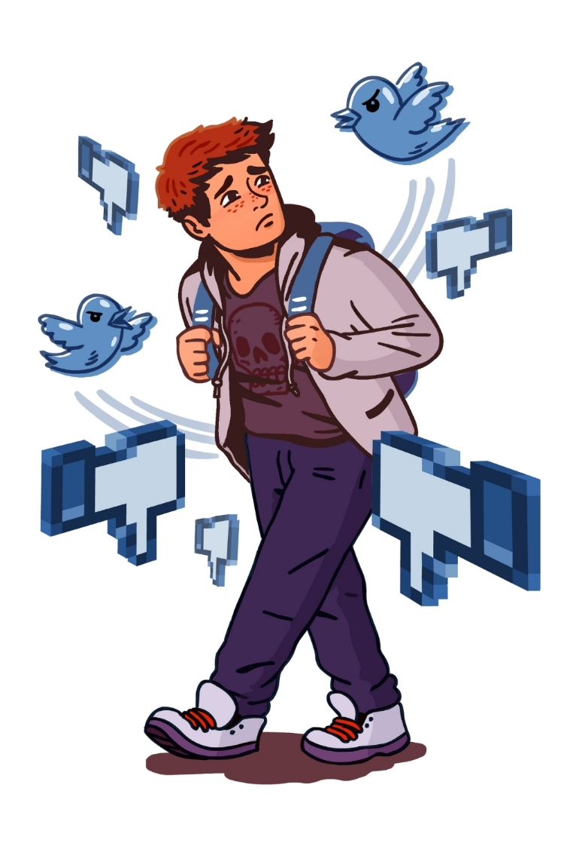
Nigel‘s Main Points
Notes:
Nigel
So for now I will be presenting on my main point that I have research on, that will be covering on the “Effect of being cyberbully” & “Measures that are taken in Singapore”.

Slide 12
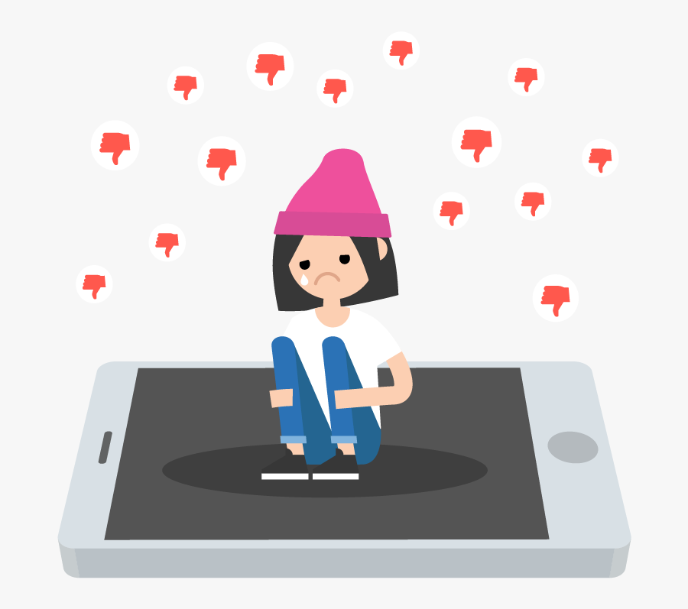


Effect of cyberbullying
Victims will feel being humiliated.
Doing badly and decreased academic grades.
Feeling depressed sad and loneliness.
People become cyberbullies because they were once a victim of cyberbullying.
Nigel
Notes:
Nigel
Cyberbullying can take place in an online environment like social media such as like twitter or even Instagram or other social network platforms. Cyber bully could post humiliating photos of even chat, towards victims of rumors about them on the internet on the intention of hates and insult and can be all seen by public strangers those things can make the victim even more effected and being humiliated.
Victims will also feel disinterested in school effecting the academic grade as they find it difficult to concentrate in school as they might feel stress the bullying causes. Worst situation is that they might even drop out of school after losing interest in education afterwards.
Being in this situation loneliness can be very sad emotions and painful and difficult to be talking about, victims will feels meaningless and losing interest in the things they once enjoyed and also spending lesser time interacting with their family member and friends.
Those victims themselves might also become bullies themselves to is partly because in response to their anger emotion and taking revenge to other people out there using the similar bullying tactics. In using all this to other target to effect the target that they are going against online.
https://www.stopbullying.gov/bullying/effects
https://www.verywellfamily.com/what-are-the-effects-of-cyberbullying-460558

Slide 13

Measures that are taken in Singapore
Teaching student in lesson and having special programmers(Cyber Wellness) to guide them whenever they encounter cyberbullies. Doing badly and decreased academic grades.
Public education like cyber-wellness will be carry out in Singapore to teach the safety of online community.
Nigel
Notes:
Nigel
Proceeding on the next slide so why must we have people to share the importance of cyber wellness? Having all this it will then allow everyone to be aware of the possible outcome and the consequences of the action of a cyber bullying on the real world network platform. From these lesson, students will then be able to handle the issues when encounter these cyber bullies. All this lesson on cyber wellness as well as prevention of cyber bullying should not be underestimated, as these are the key important advice action such as like blocking communication with bullies and not reading unknown messages.
As cyberbullying is common in all different ages, be it insulting victims on the internet or spreading rumors through social media like Facebook or others platform. That is why more and more public education have been carrying out in the community to guide and teach on how they should do whenever they encountered cyberbullying situation. Simple stuff like keeping their personal information private these can avoid the danger that might face online. Also the focus are to help public to become more responsible in the network platform and practice safe and responsible use of technology. So next up Marcus will be covering on the recommendation slide.

Slide 14
Recommendation
VICTIM
Do not be afraid to seek for help
GOVERNMENT
Educate the public about cyberbullying
Stricter laws
PARENTS
Be aware of what their child are doing
Marcus
Notes:
Marcus
Recommendation
-------------------------
We will be suggesting on what the victim, parents, schools and the government should do. First I will talk about the victim, the best and the most effective they can do is to seek help from other people, They should not be afraid or embarrassed to find someone to speak about with. Another action that the victims can do, is to use the technology tools to block, remove or unfollow the bullies from their feed. Although others may still see it, preventing any more content that may hurt themselves further should be the very first thing to do.
Next, for what the government can do is to educate the public about the dangers of cyberbullying. Such as arranging awareness talk for schools to help students to understand more about cyberbullying. By knowing and understanding the causes and effects of cyberbullying can help with how they treat other people online or even help out a cyberbullying victim if they ever come across one. Another thing that the government can do is to set stricter laws on what people can and can’t get away with. As of now, there are still a lot of serious incidents where the bullies are able to avoid any sort of punishment. To prevent this, what the government can do is fine the bullies a set amount of money if they ever get caught doing it. This could act as a deterrent to help decrease the number of cases that can happen.
Lastly, for what parents can do to help. Parents can try to keep up with the online things that their child does every now and then. Or maybe place the computer in a central area of the house, where they can monitor what goes on with their child. Parents can also help by practicing the appropriate use of technology with the child. This can prevent their child from becoming the cyberbully and also prevents the potential victims. There is a lower chance that the child will commit an act of cyberbullying if the parents are strict about what they can and cannot do on the internet.
Conclusion
----------------

Slide 15
Conclusion
Cyberbullying is a problem in societies and it is not easily fixable. It can cause many different psychological traumas to anyone but it is most prominent in today’s youth.
It is not an easy task to prevent as it will required parents and government to be aware of the problem and act on it. Eliminating cyberbullying is not a one night, it takes a combined effort to do so.
Marcus
Notes:
Marcus
Cyberbullying is a problem in societies and it is not easily fixable. It can cause many different psychological traumas to anyone but it is most prominent in today’s youth.
It is not an easy task to prevent as it will required parents and government to be aware of the problem and act on it. Eliminating cyberbullying is not a one night, it takes a combined effort to do so.
Therefore the parents should be also aware of what kids are doing on the internet and their phone, check if they are doing something that they should not be doing.

Slide 16
References …
BROOKE DE LENCH. (n.d,). Momsteam. Retrieved from Momsteam 10 tips teen prevent cyberbullying: https://www.momsteam.com/health-safety/10-tips-teens-prevent-cyberbullying
Duverge, G. (2015, Jul 15). Digital Threats: The Impact of Cyberbullying. Retrieved from TUW: https://www.tuw.edu/health/impact-of-cyberbullying/
Gordon, S. (2020, Jul 10). The Real-Life Effects of Cyberbullying on Children. Retrieved verywellfamily: https://www.verywellfamily.com/what-are-the-effects-of-cyberbullying-460558
Lin, O. (2020, April 04). Cyber bullying is a growing danger in S’pore & you should be concerned about it. Retrieved from mothership: https://mothership.sg/2020/04/cyber-bullying-singapore/
Paulo, D. A. (01 Mar, 2018). 3 in 4 youngsters say they have been bullied online. Retrieved from CNA: https://www.channelnewsasia.com/news/cnainsider/3-in-4-teens-singapore-cyberbullying-bullied-online-survey-10001480

Slide 17
THANK YOUU

